Slide 1
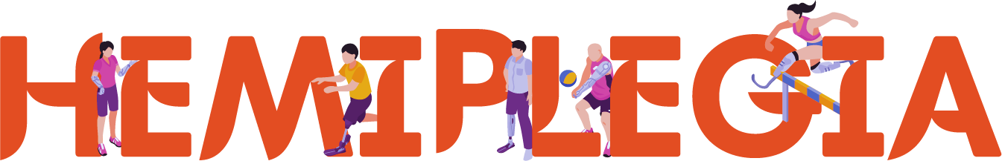
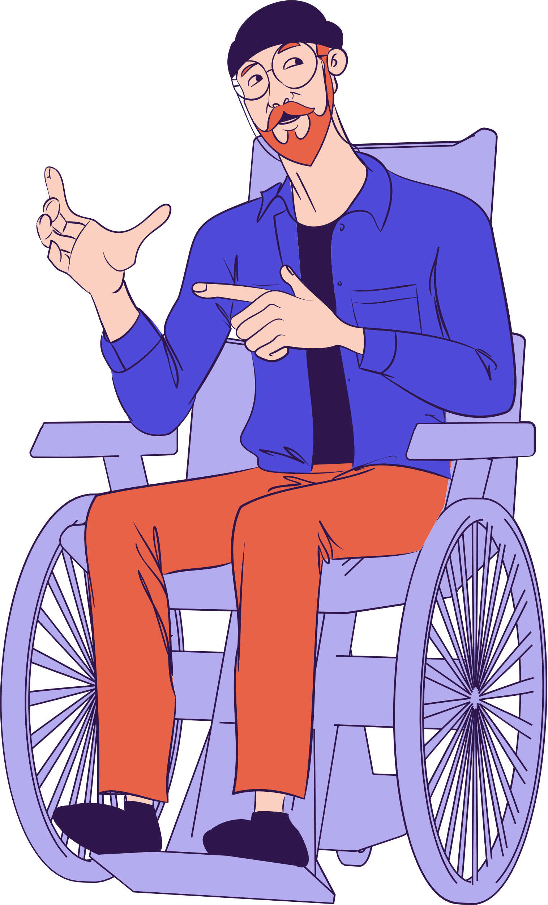
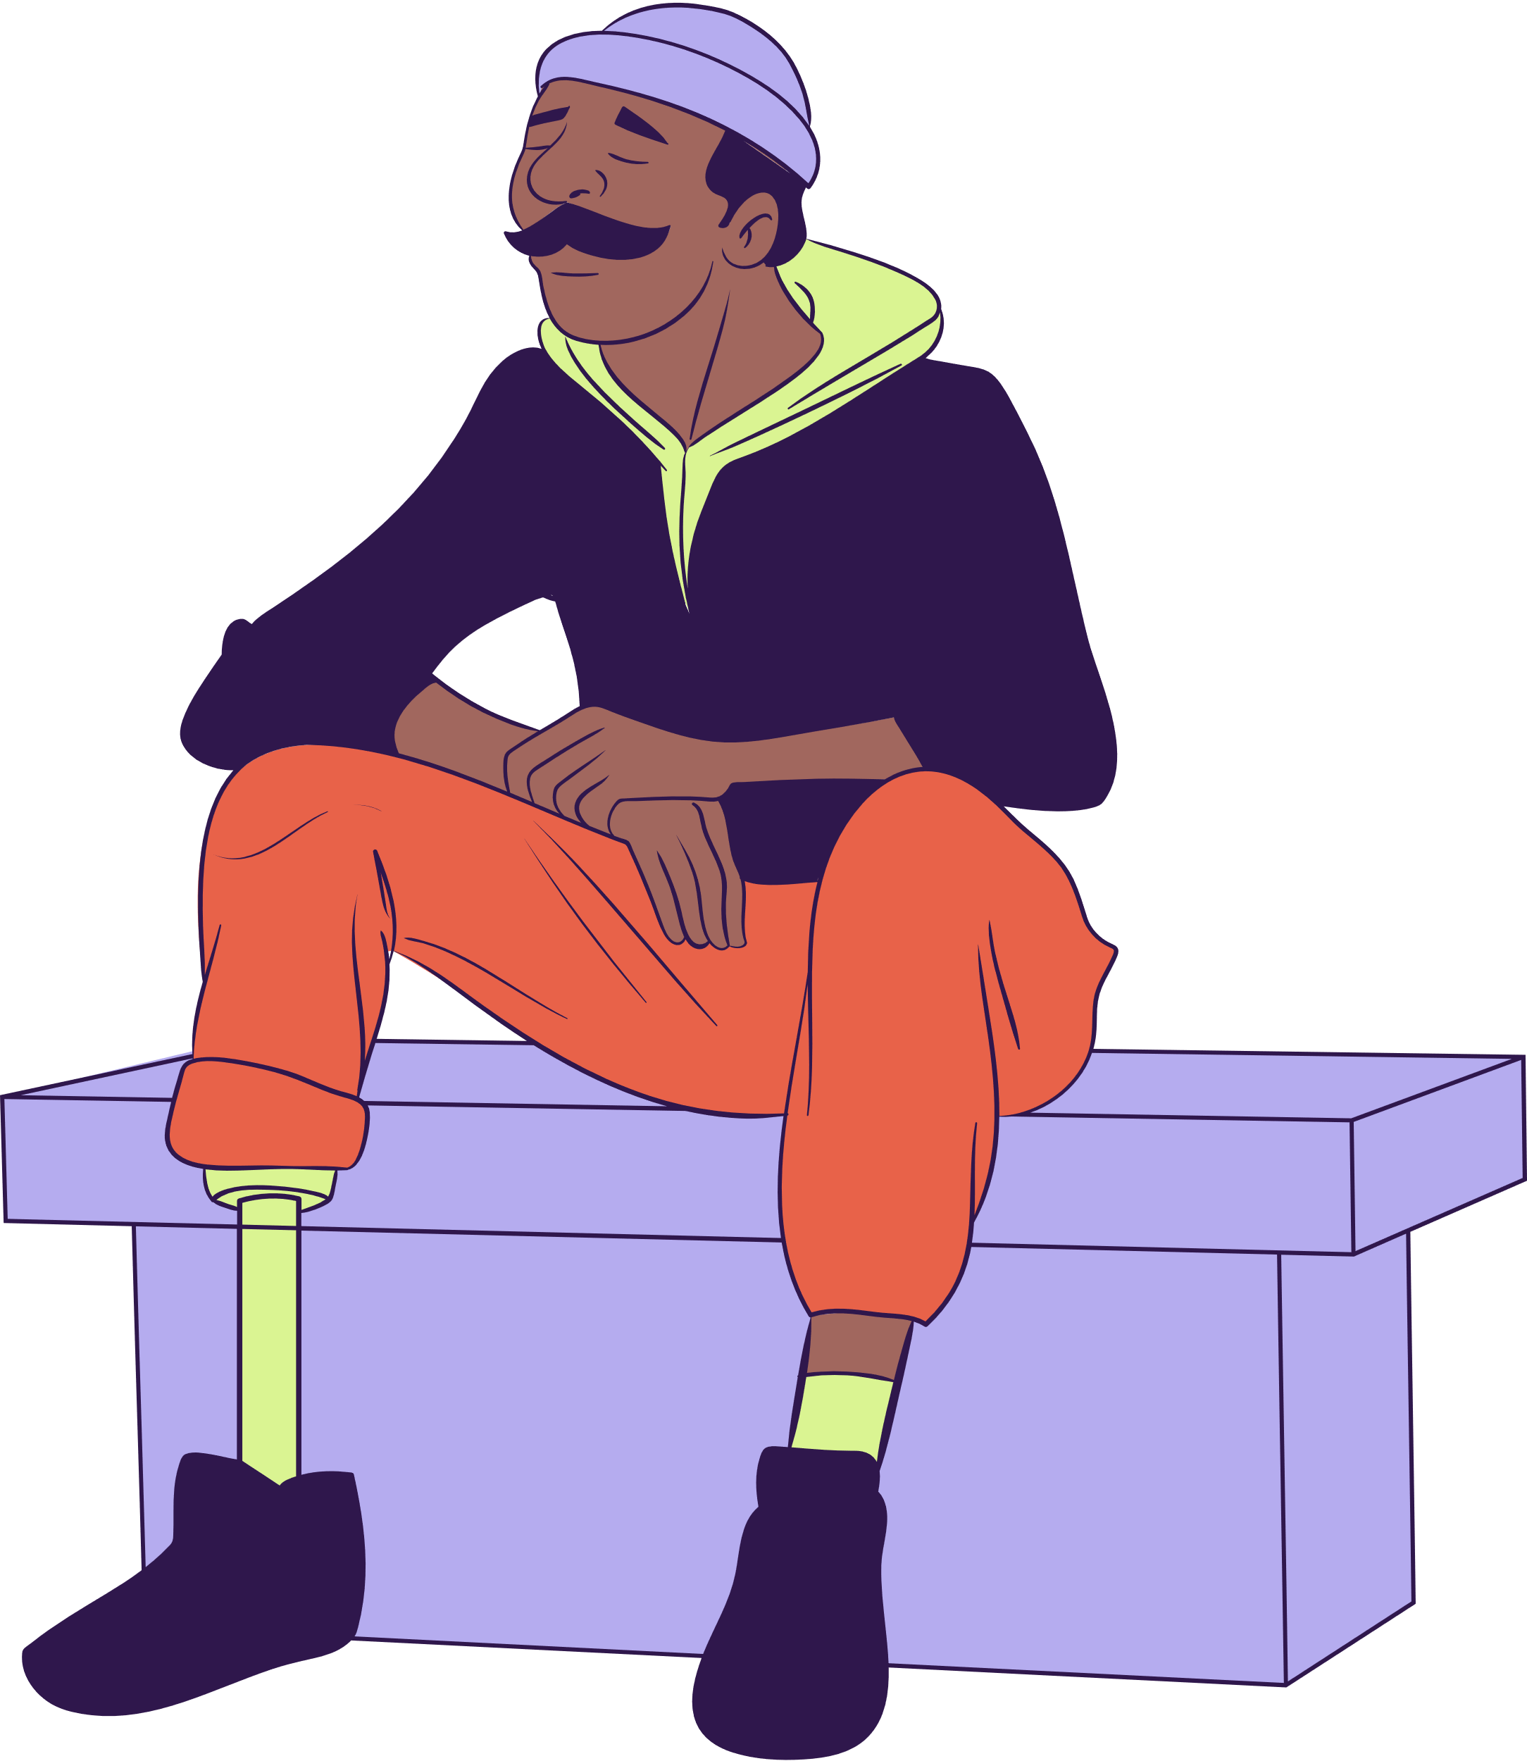
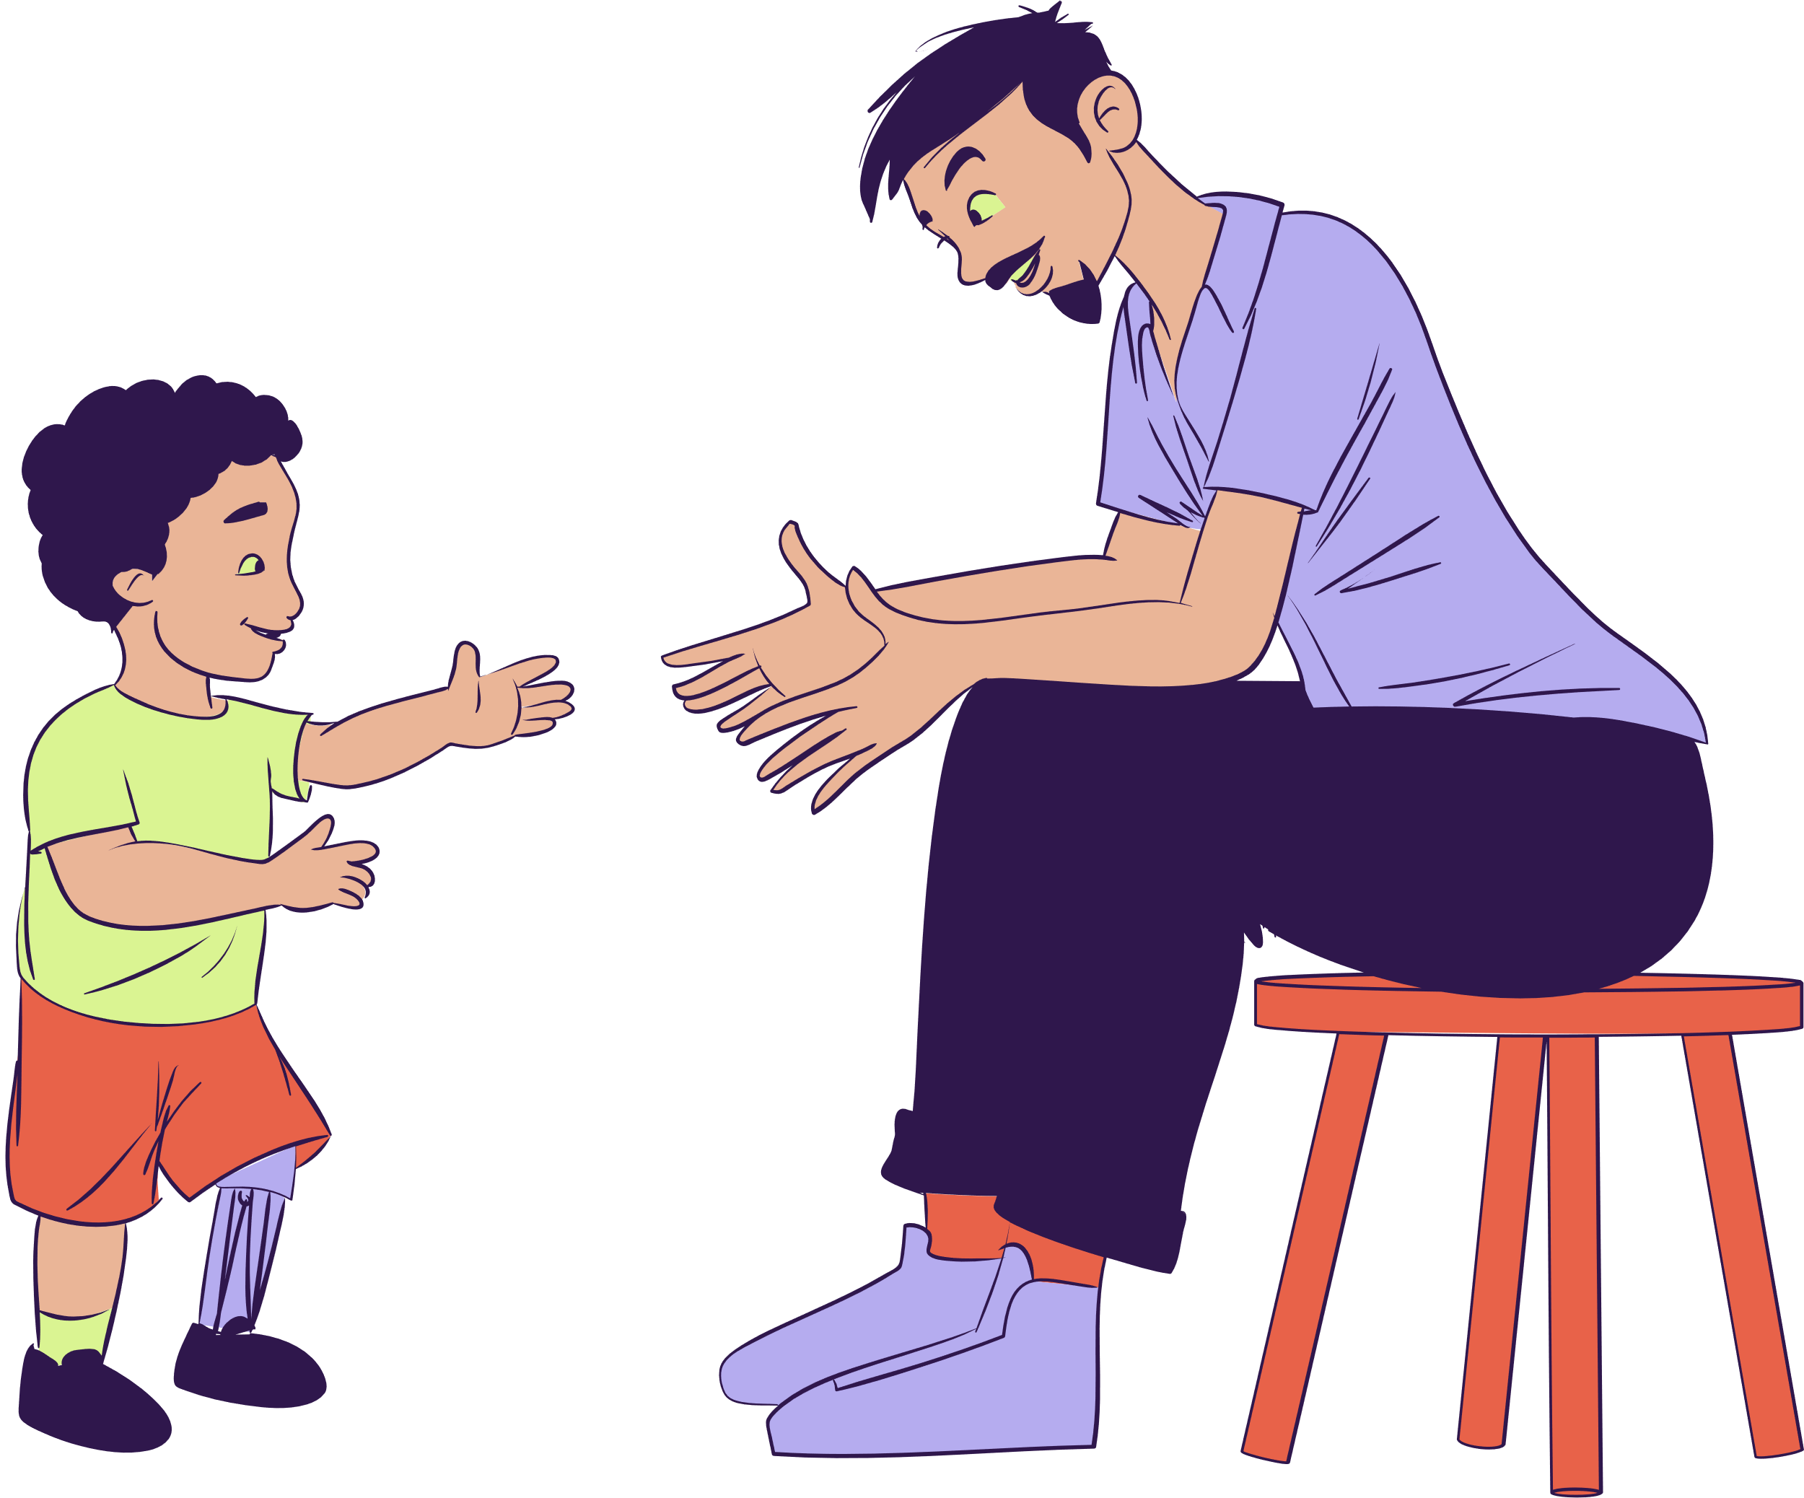

Effects and Impact

Slide 2
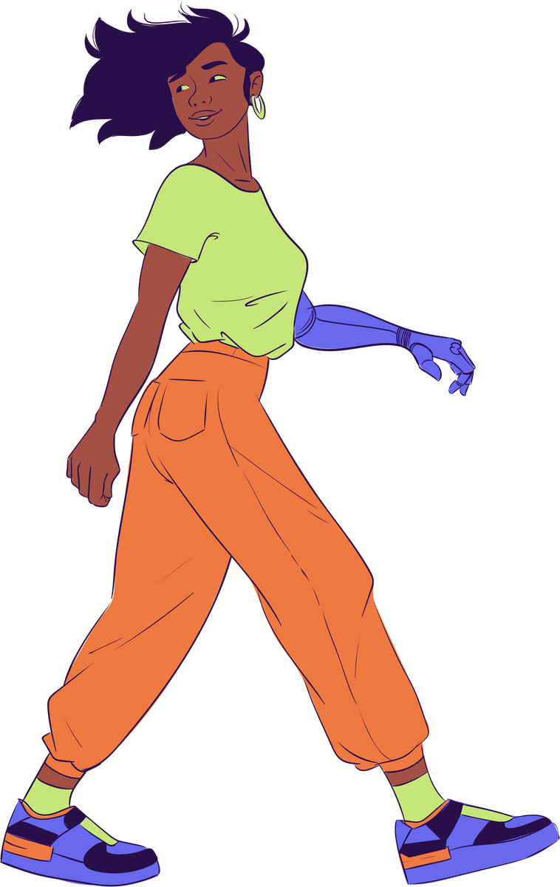

Content
What is Hemiplegia?
My Experience
Impact on the Body
Technologies in Aid
Games for Recovery
Community
Let’s Connect
Stylized illustration of a figure
in motion with a prosthetic arm

Slide 3
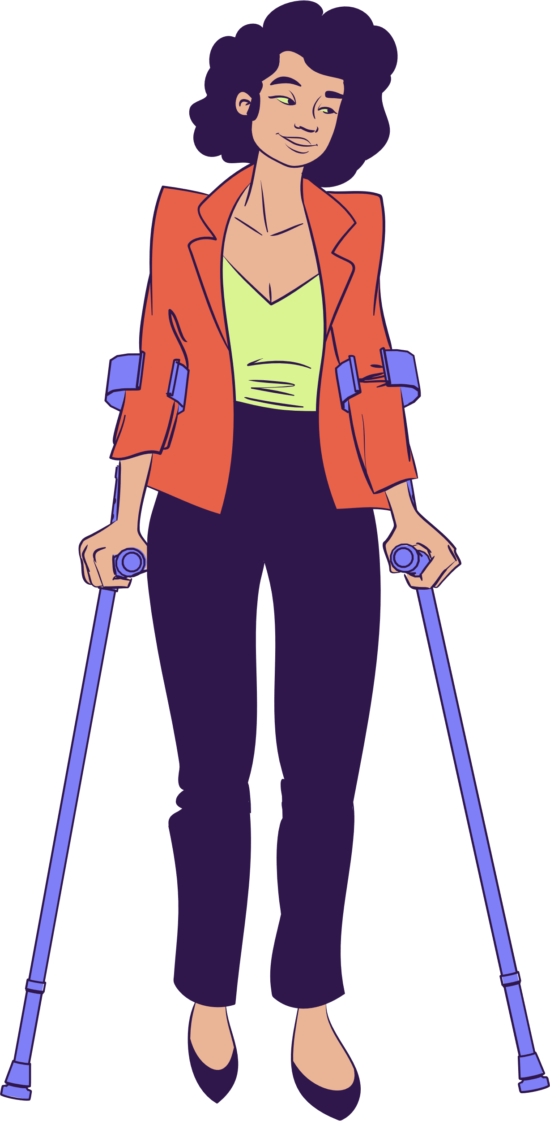
What is Hemiplegia?
One-sided paralysis
Can affect: Arm, Leg, Face, Speech
Ranges from mild weakness/full paralysis
Can make your body weak/floppy

Slide 4
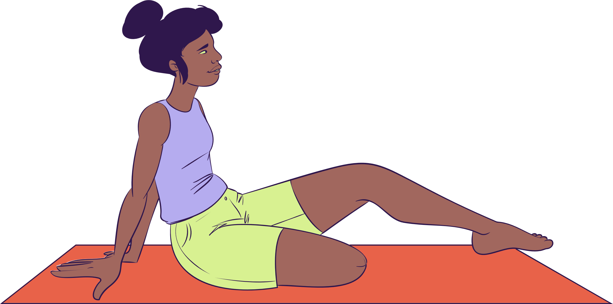
My Experience
I had my stroke at age 3
Very few memories of the experience
Regained mobility in left hand
Little mobility returned to my leg
Stylized illustration featuring
a woman with an amputated leg

Slide 5
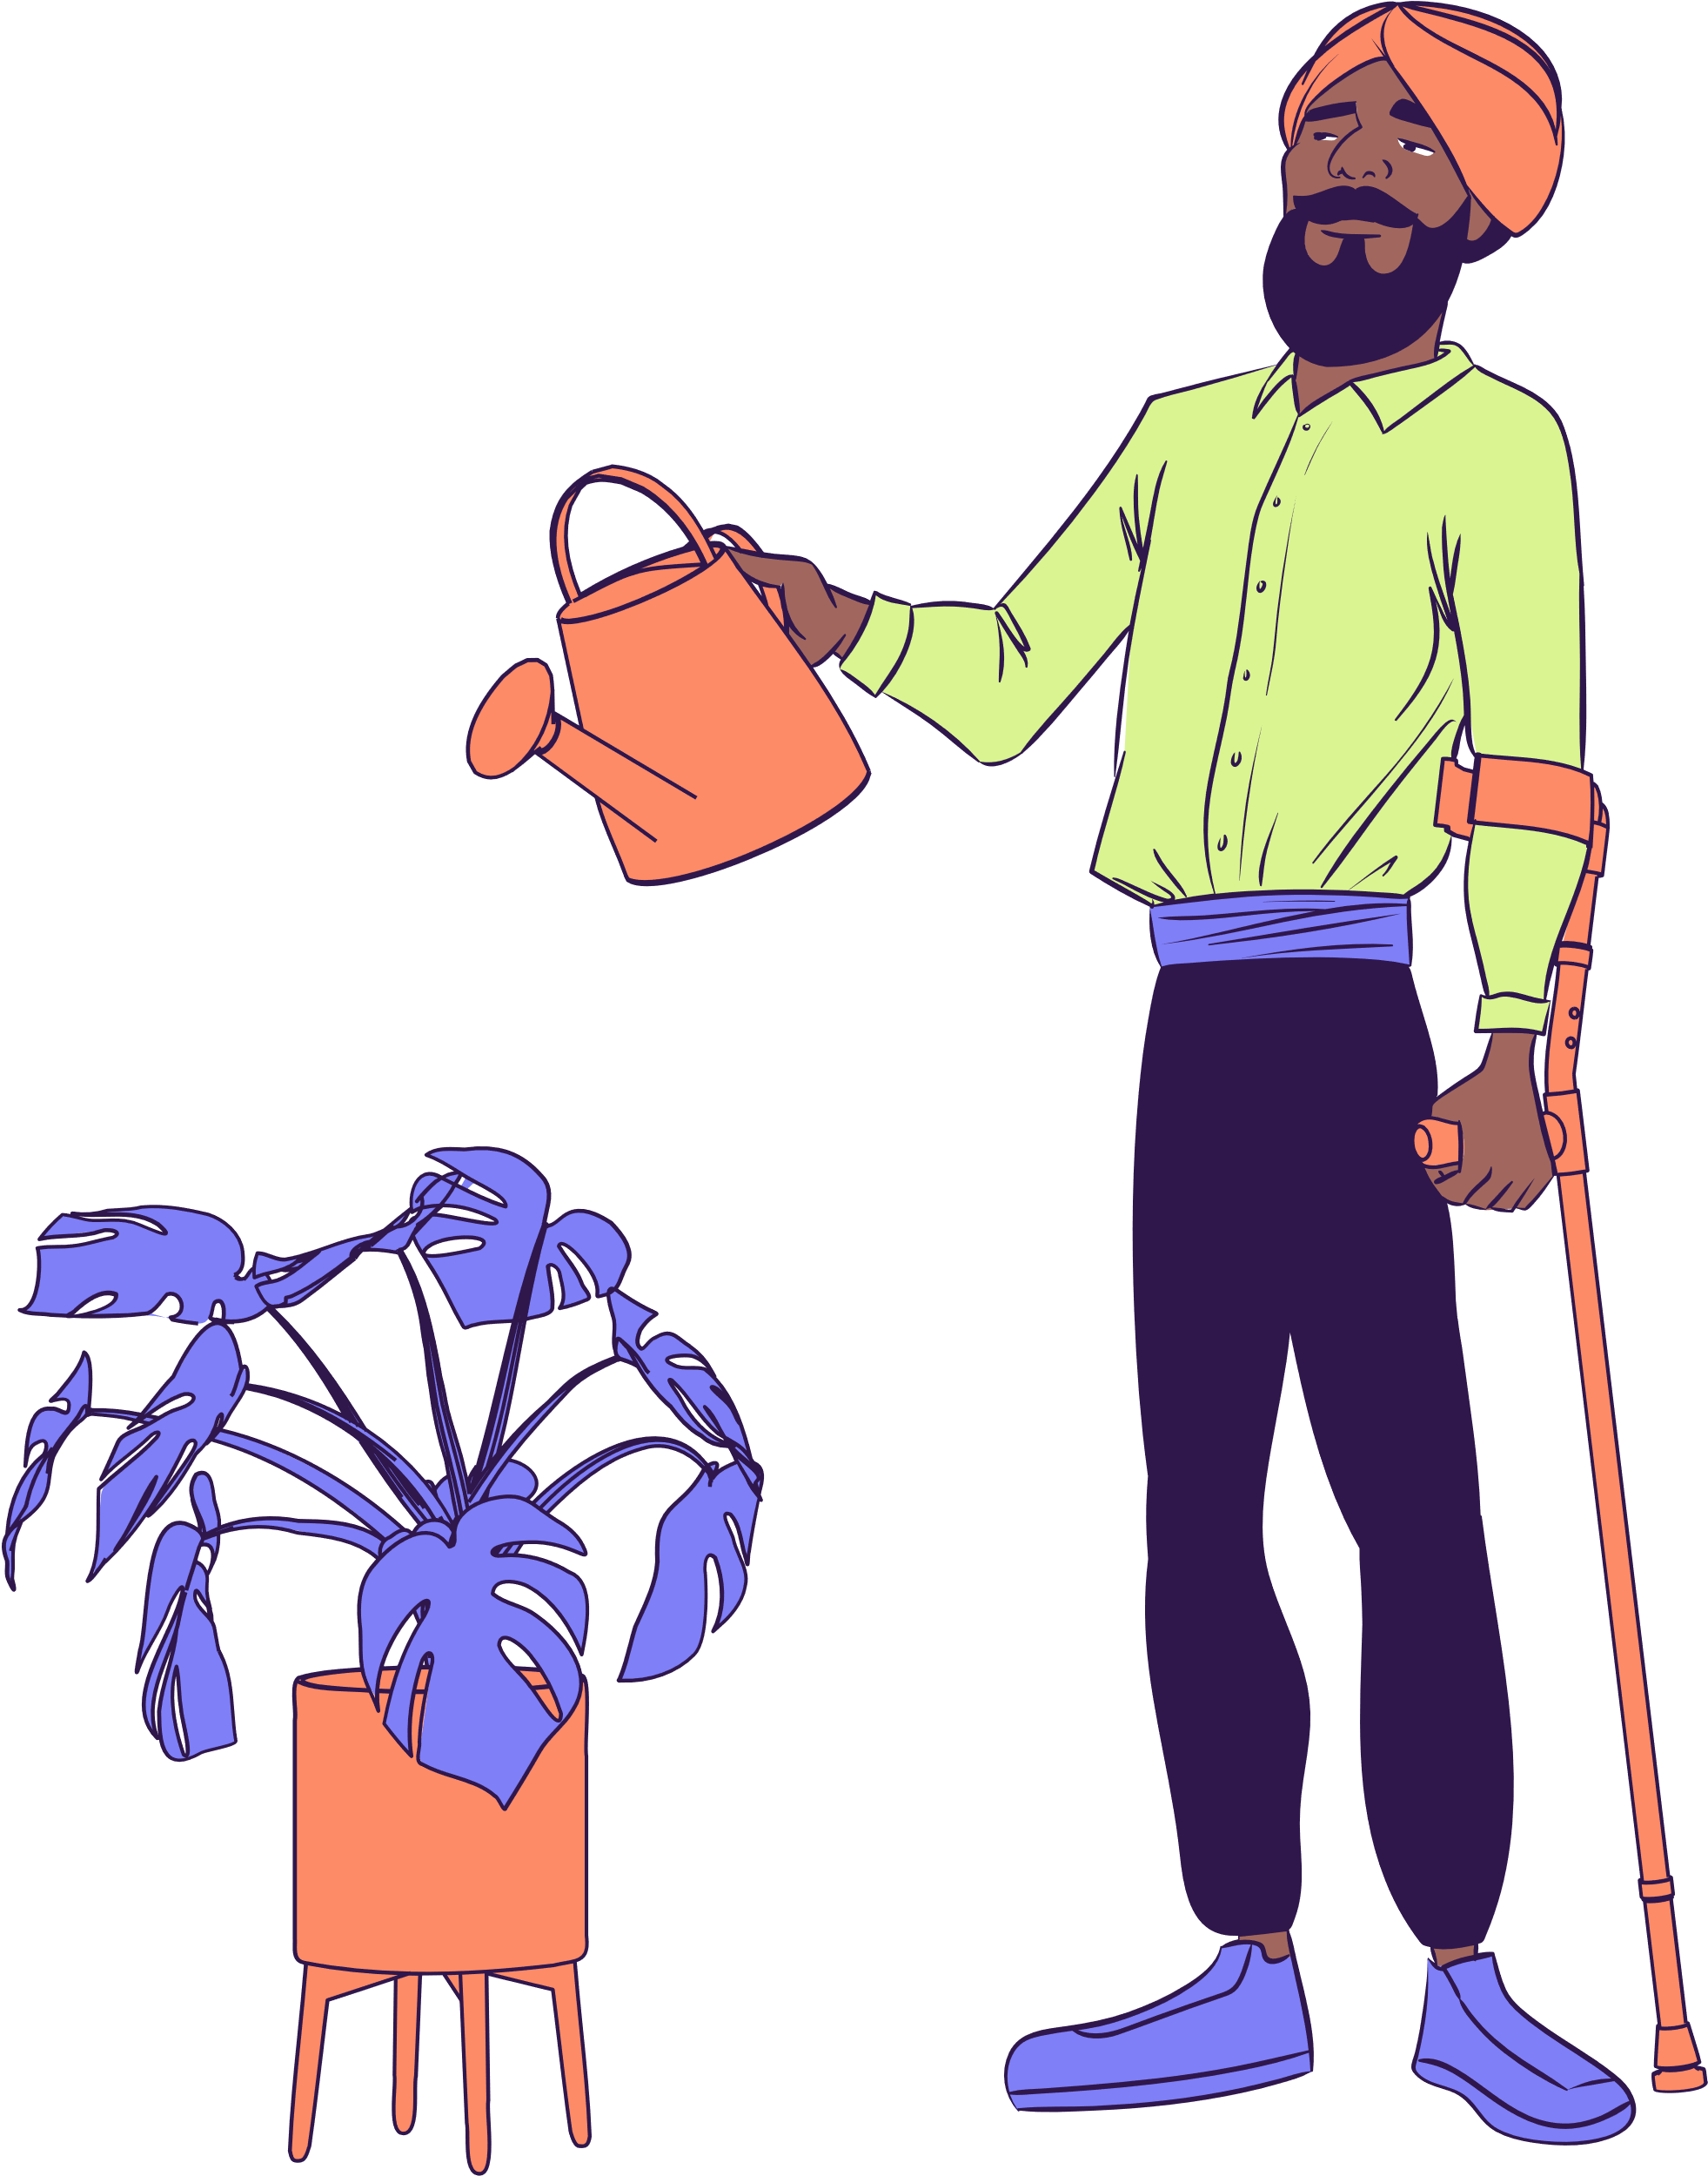
Impact on the Body
Impact varies by severity and area
Affects movement and mobility
Reduces muscle strength and control
May limit independence in daily life

Slide 6
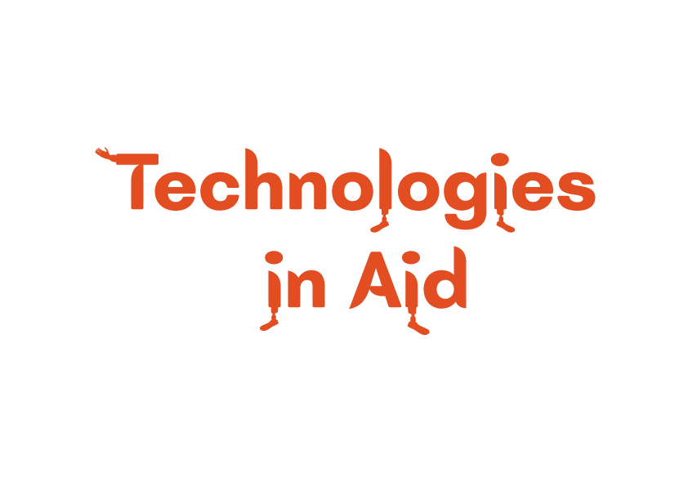
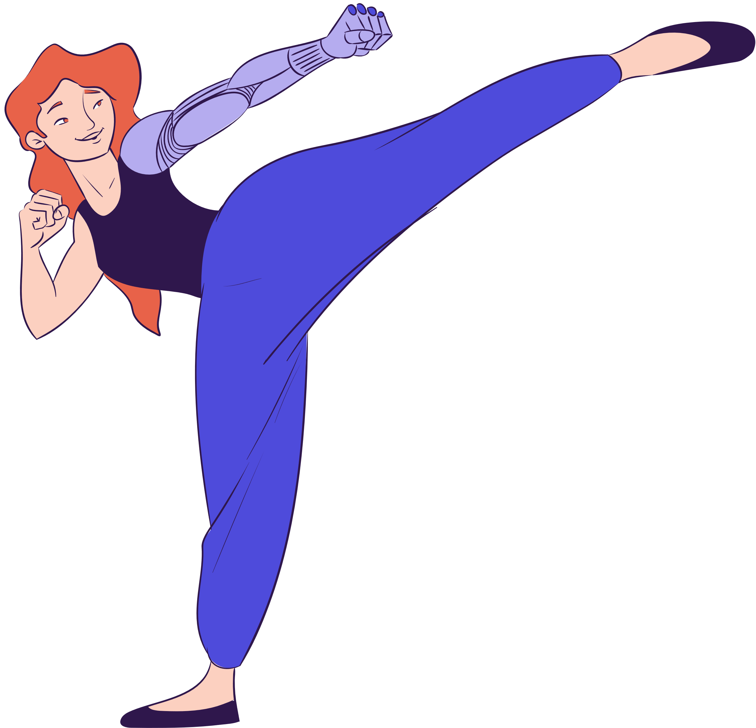
KAFO: Knee-Ankle-Foot Orthosis
Stabilizes joints, supports the full leg
BBG controller: The BrightBrainer Grasp
Aids hand function in gaming
Exoskeleton - wearable device enhance movement

Slide 7
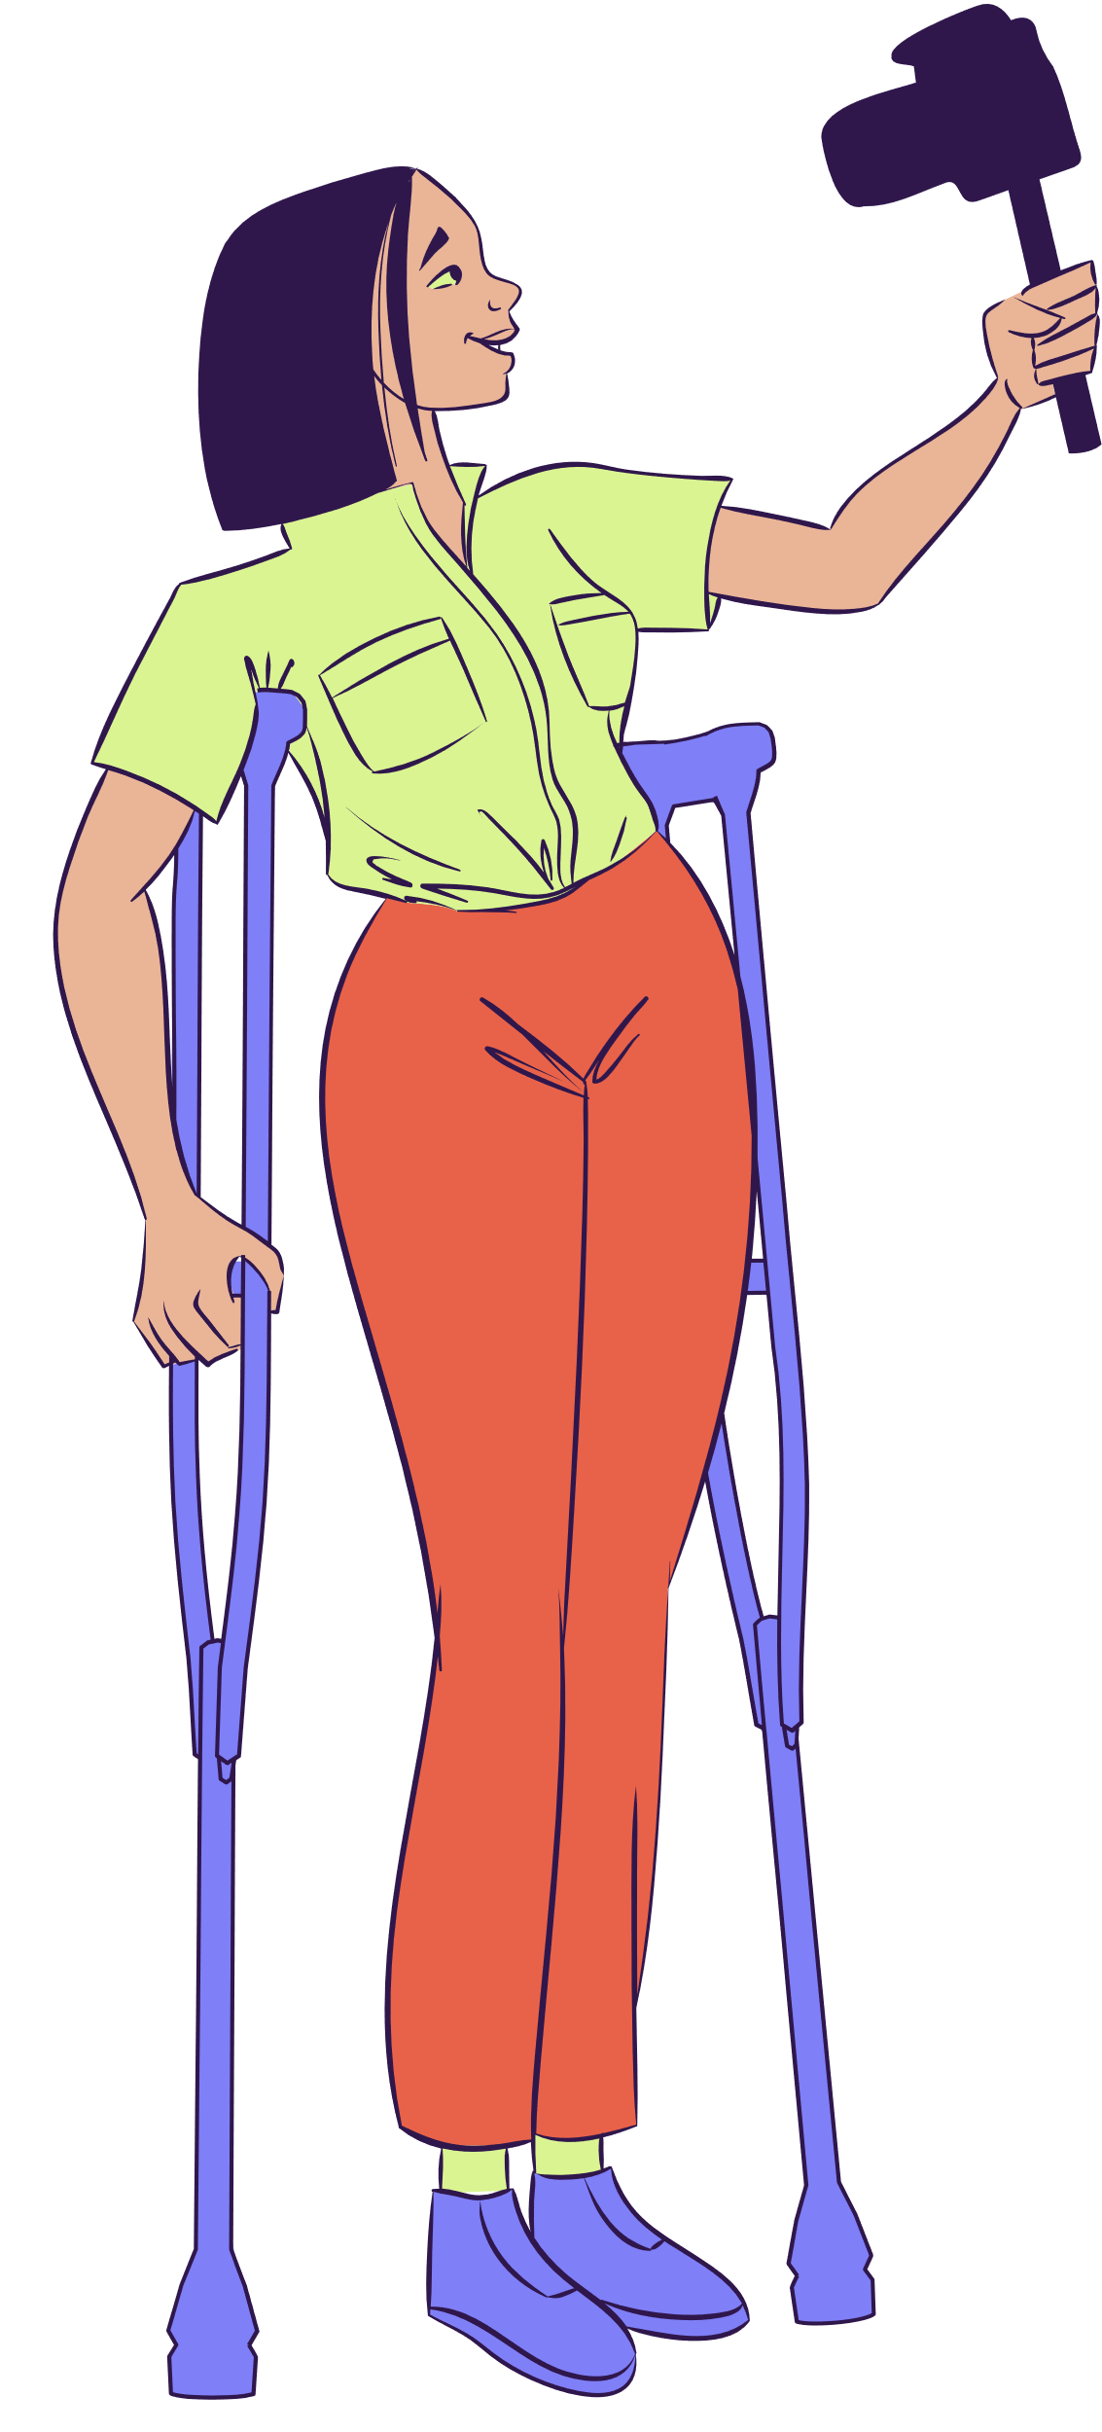
Games for Recovery
Differences: boosts attention & processing
Spot differences in similar images
Recovery Rapids: safe rehab environment
Encourages limb use & motor skills
VR games: provide escapism & immersion

Slide 8

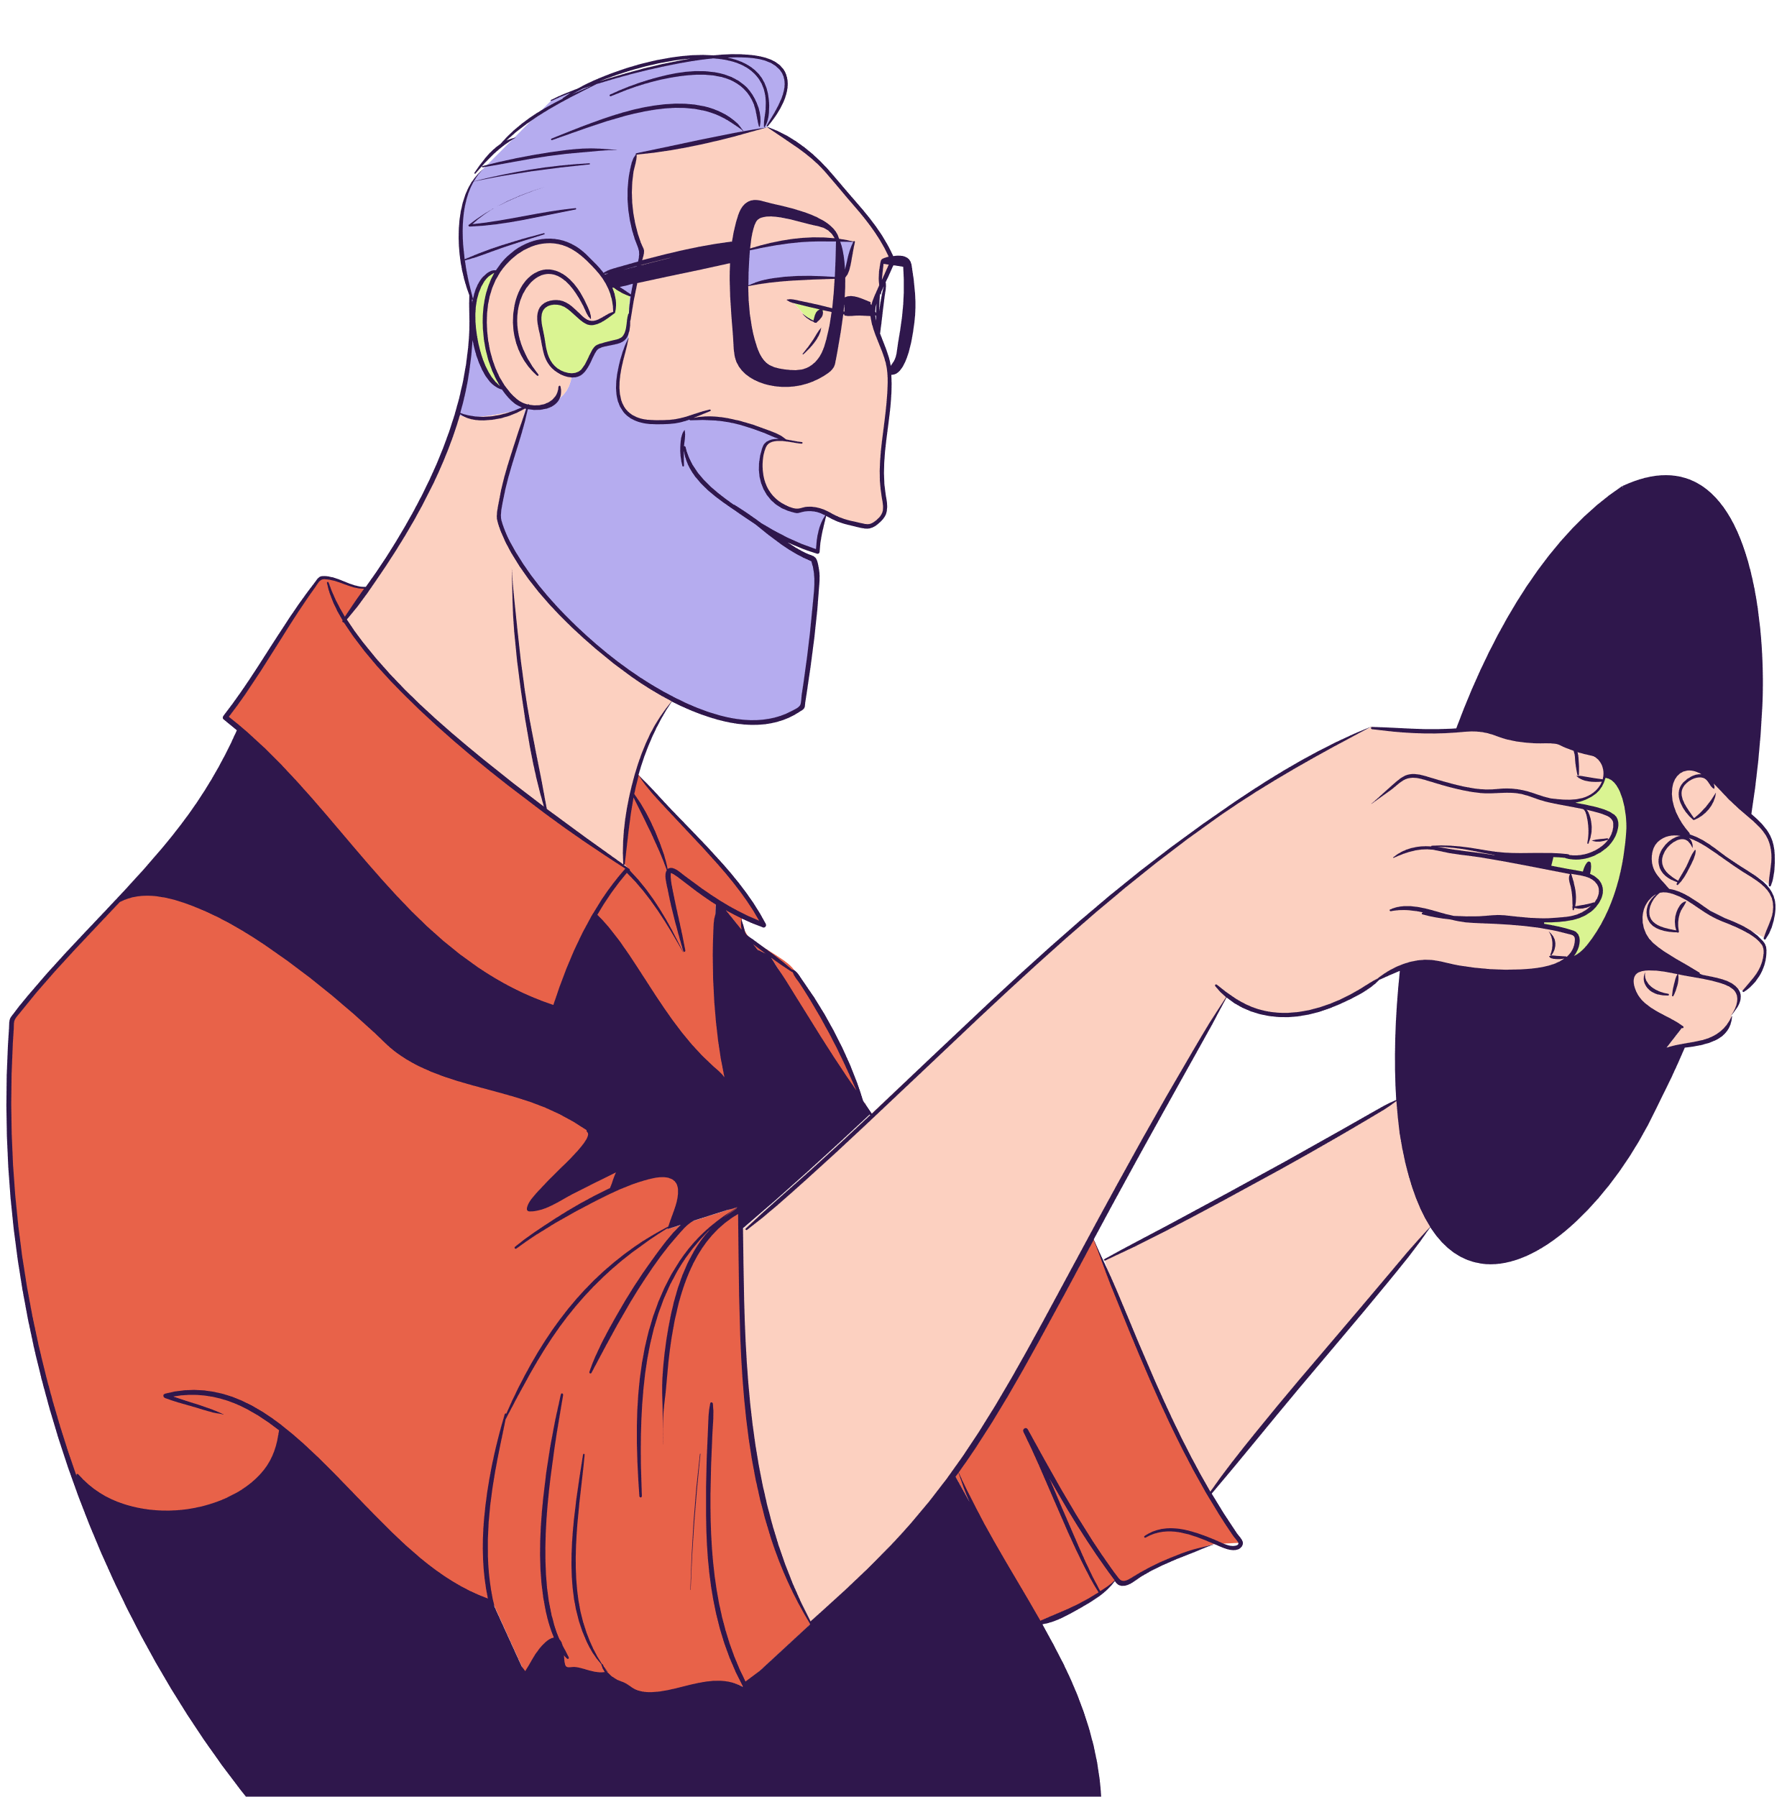
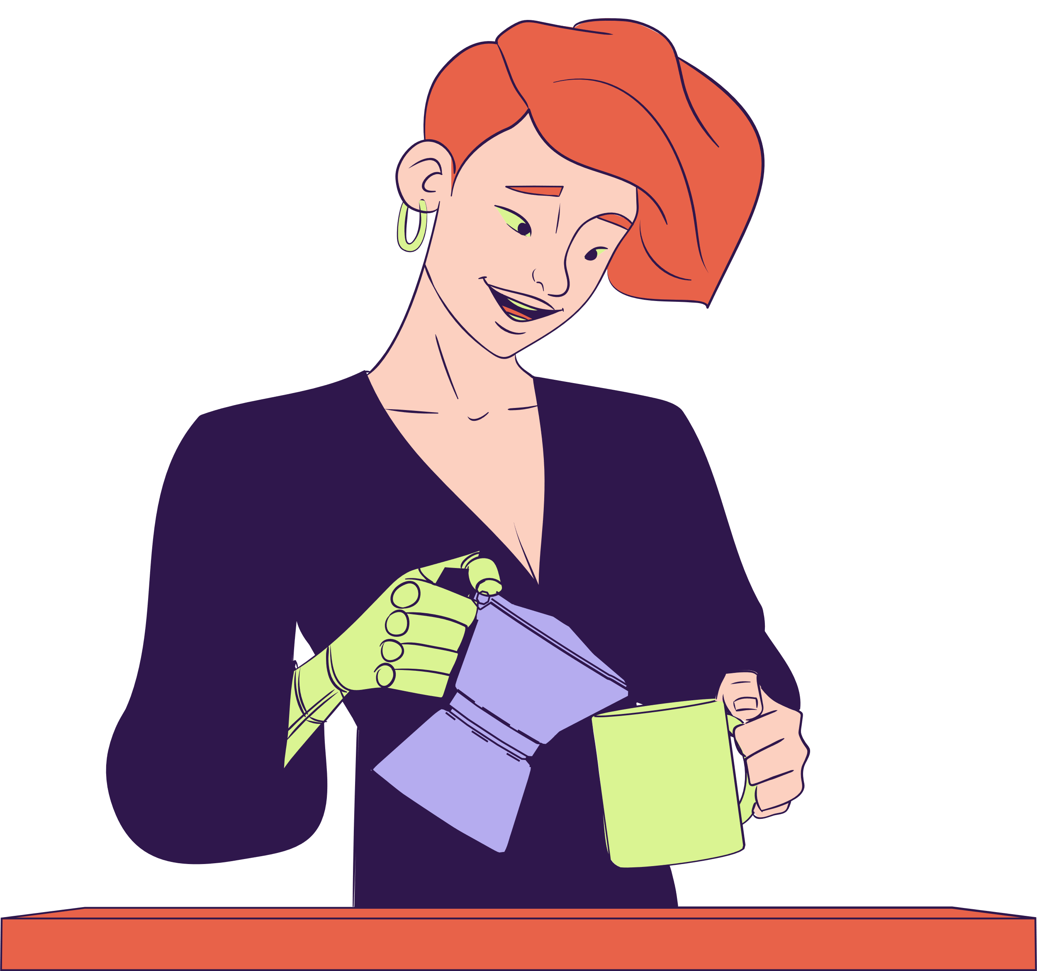
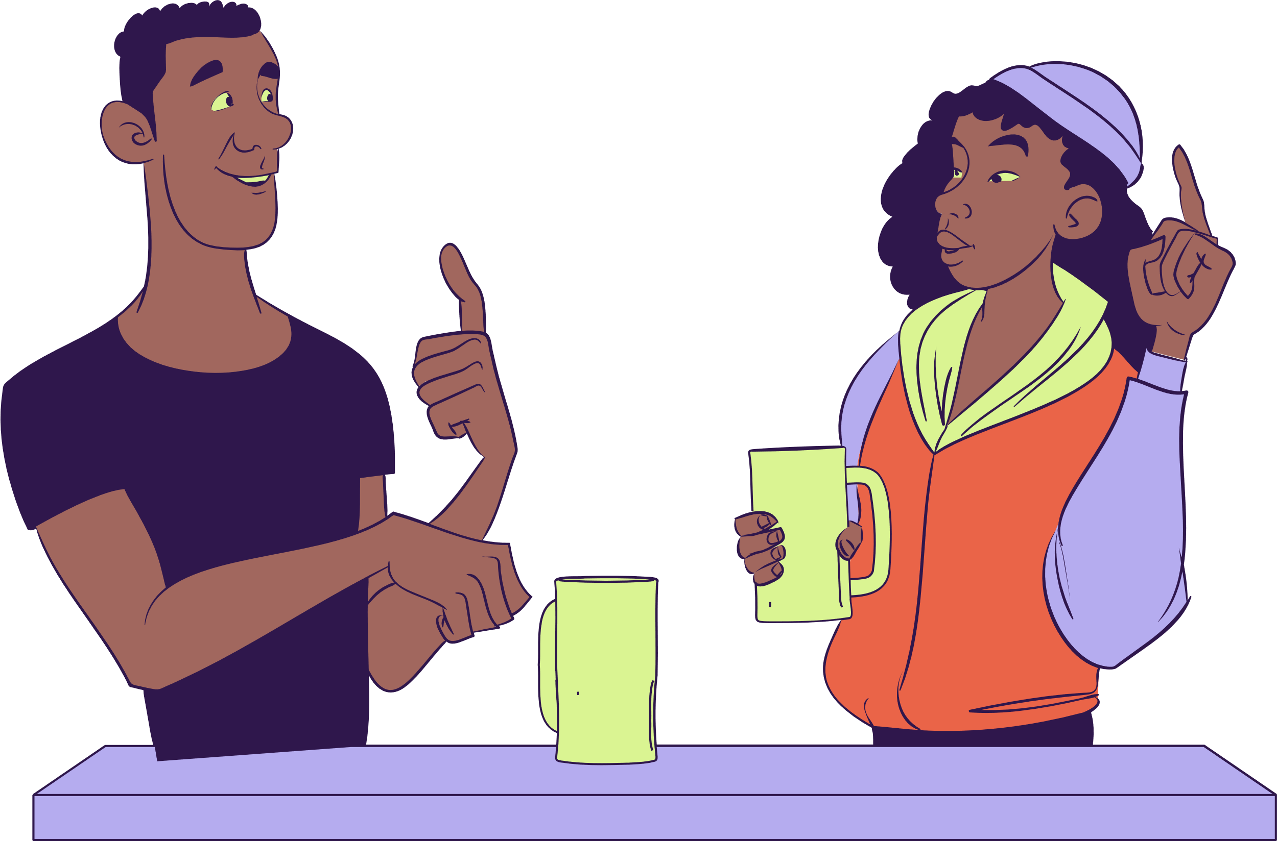
Community
AbleGamers: a nonprofit for disabled gamers
FB group: Disabled Gamers, Geeks & Nerds
Provides a forum for gamers to connect
Game Accessibility Nexus: database & news

Slide 9

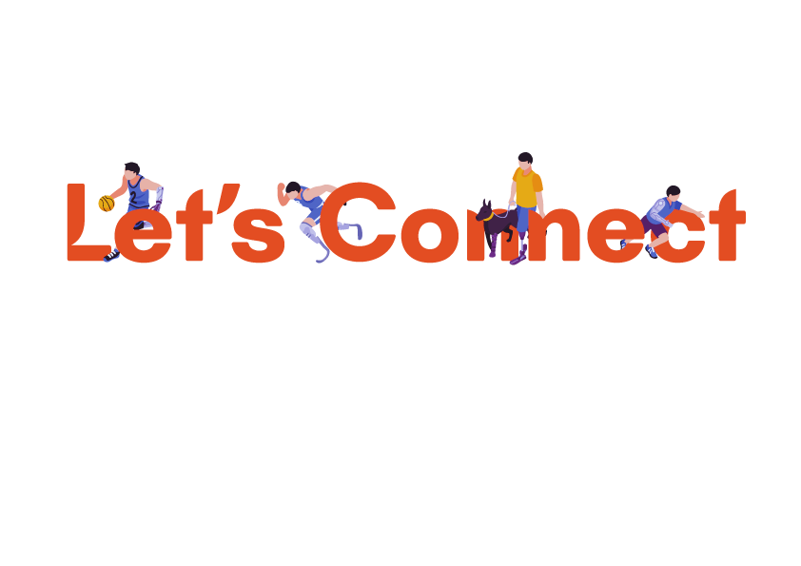

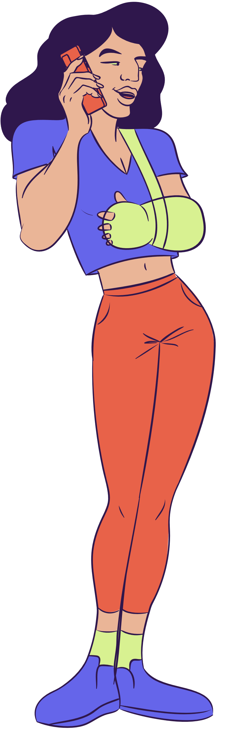

Towela Banda
Towela.banda@ucf.edu
Sources:
Graphics retrieved from Canva.com
Images by [Macrovector], Freepik.com

